Slide 1
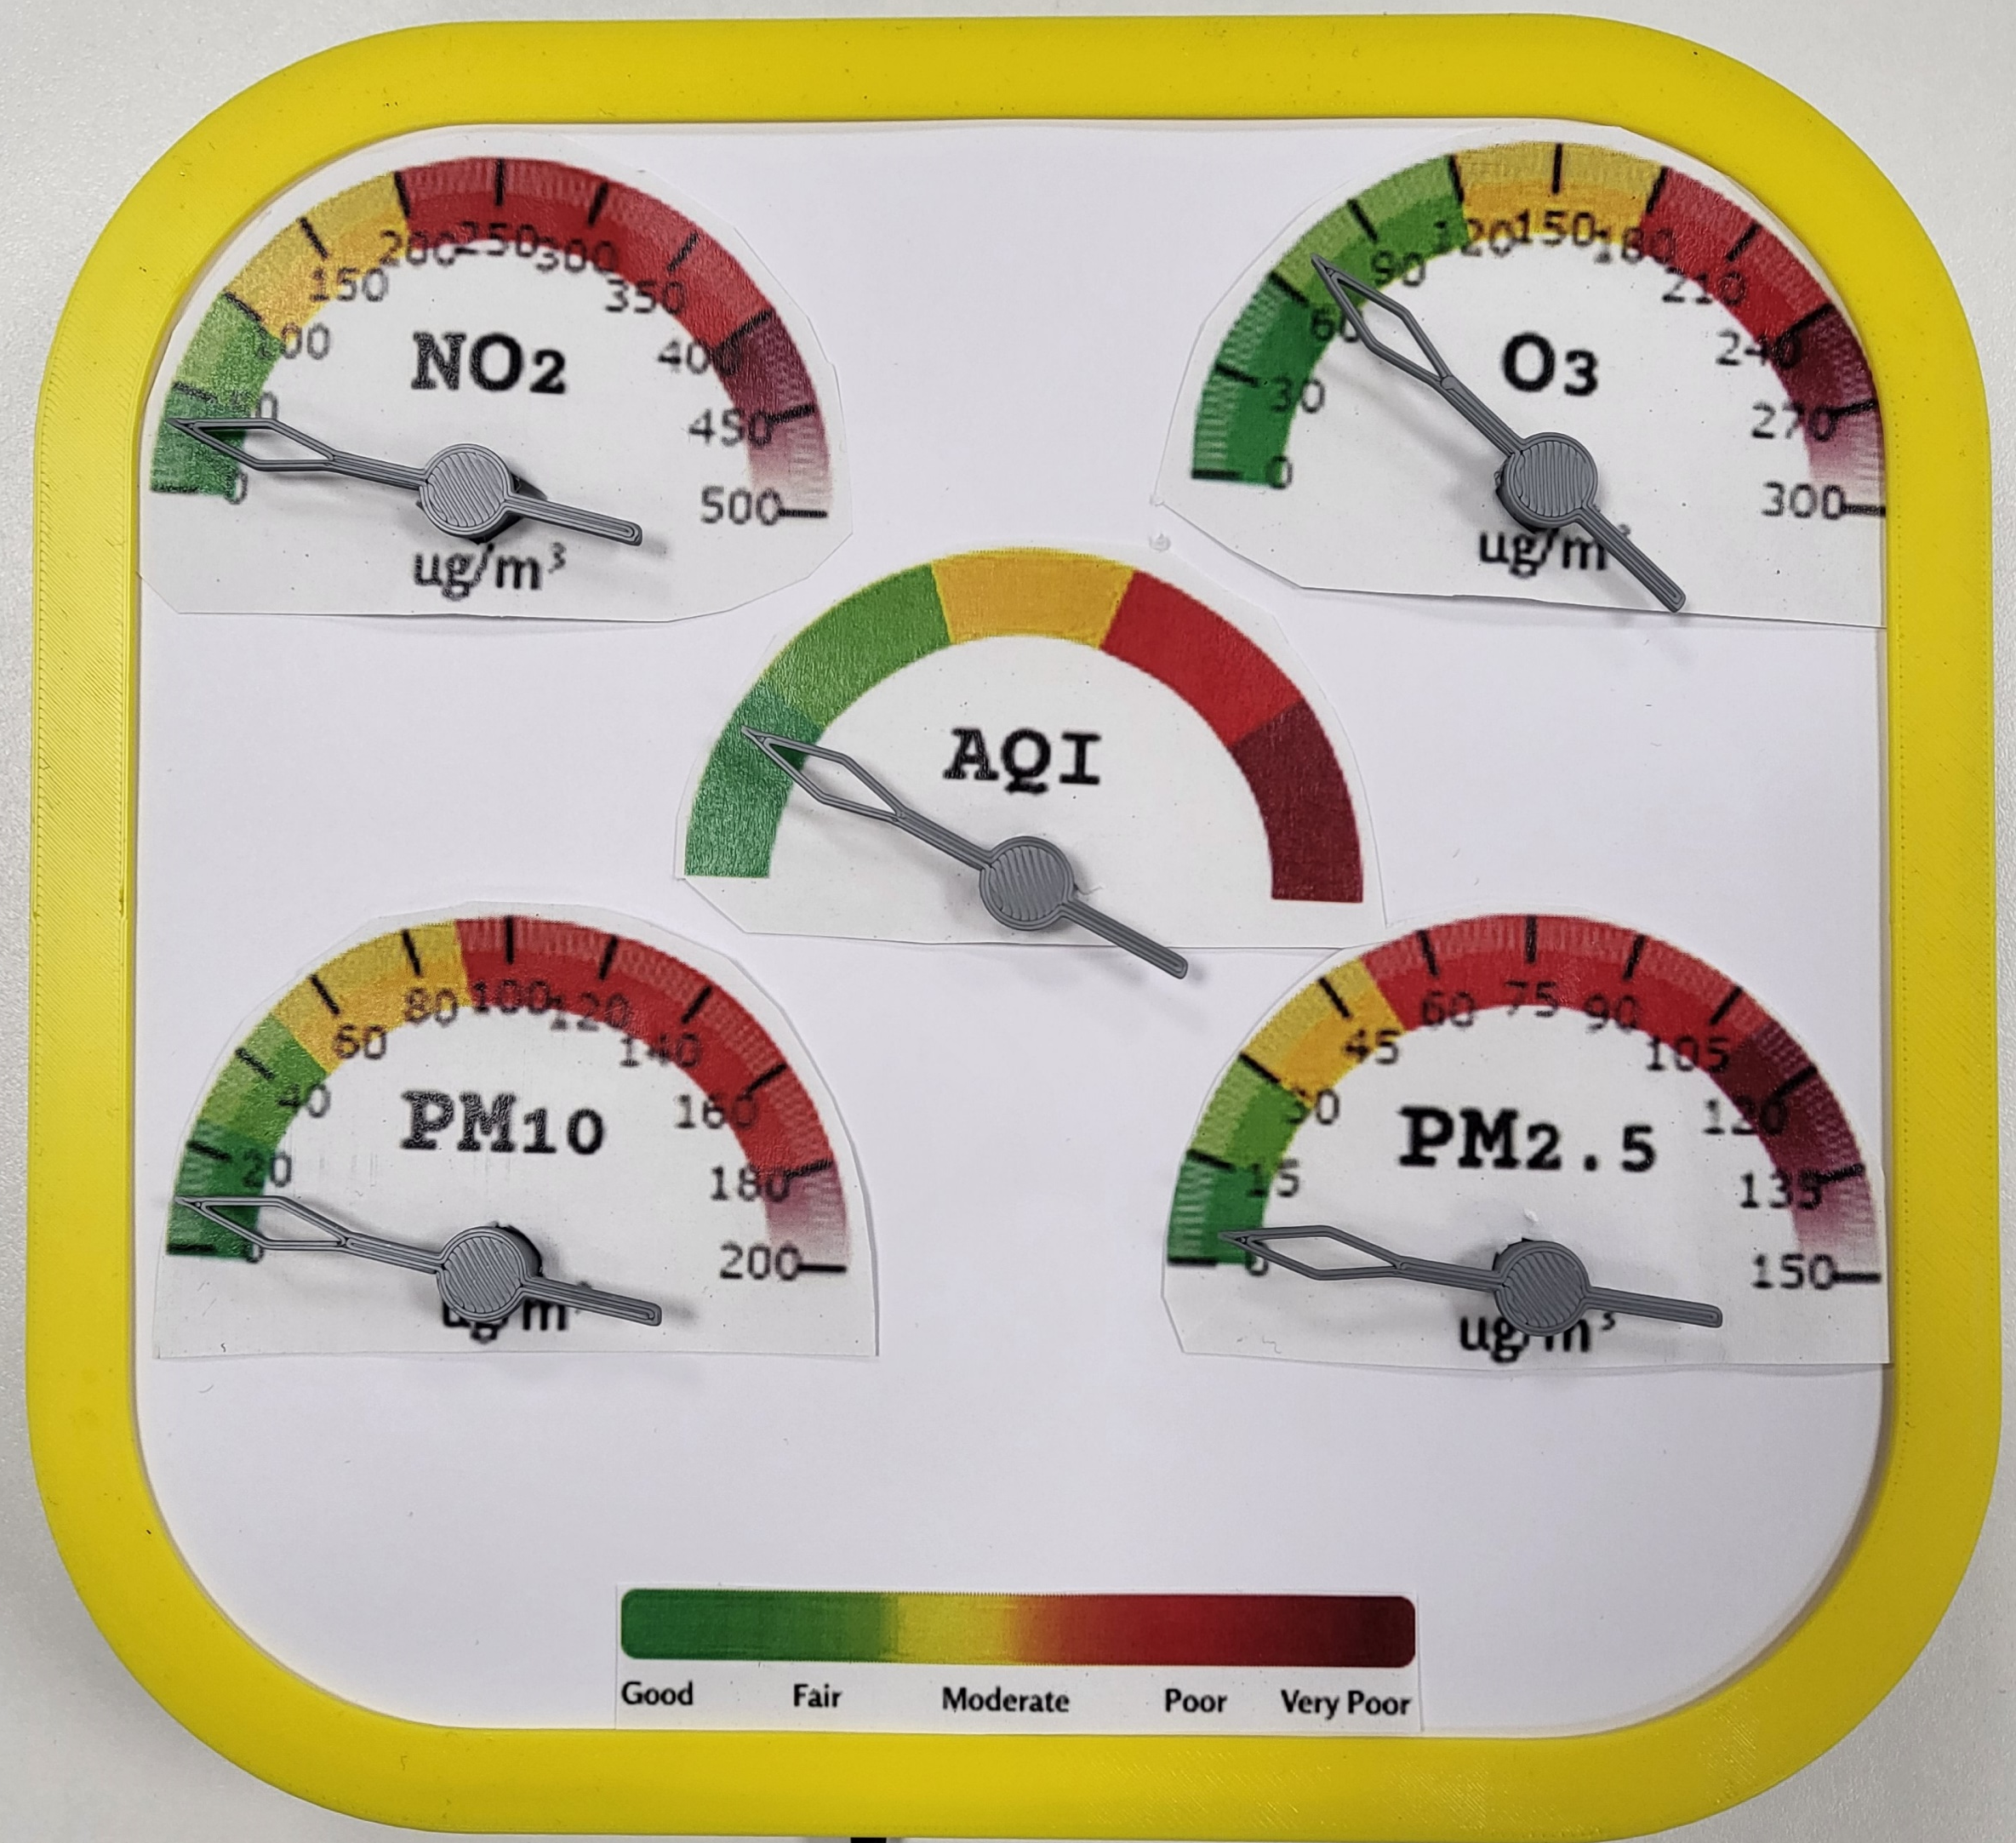

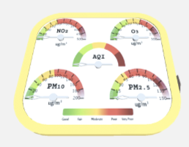
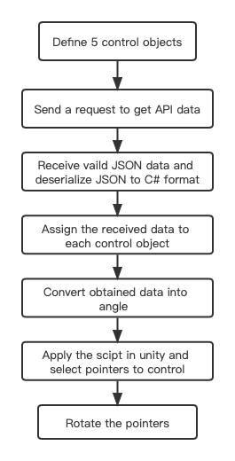
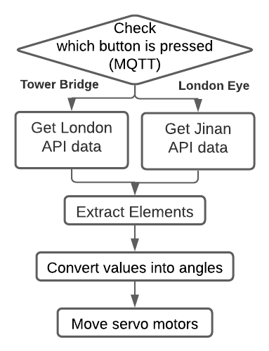

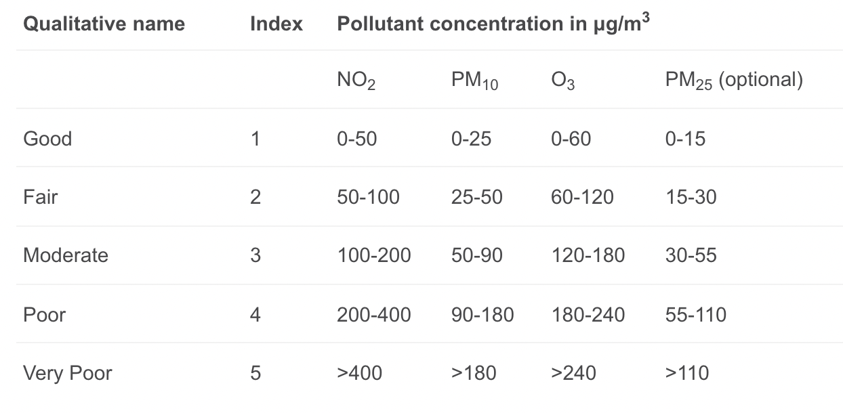

London
LondonAQ
LondonAQ
Data Device
Data Device
Rookie
Code
AQ
Physical
Digital
Development
Decide what data to display
Create 3D model of the device in Fusion360
Servo motor holders
Node MCU holder
Servo driver holder
Pointer
Base, dial face support, holders
Export and 3D print the device
Assemble!
Code!
Purpose
Code
LondonAQ is a multiple-value gauge which displays real-time air quality data to the public. Since there are 9,400 premature deaths per year are attributed to poor air quality in London (London Councils), there must be a way to reveal the issue and to call for action in a simple and intuitive way.
LondonAQ offers a quick way to identify a range of values by the colour coding in its dial. It visualises the concentrations of four pollutants and the air quality index on the physical gauge and its digital counterpart.
Development
1.Receive the 3D model of the device
2.Import model to prefab
3.Write script to control pointers
4.Get api data and convert data to angle
5.Pointer rotate!
*For testing purpose, different cities’ API are used
Use
Data
Users can see the pointers are sync in physical gauge and the virtual one, allowing users to check the readings wherever and whenever they want.
LondonAQ also provides an opportunity to display the data for various areas by choosing the location on its App, giving more user engagement and evoking people's curiosity.
What is AQI?
AQI Standard
An Air Quality Index (AQI) is used by government agencies to communicate to the public how pollute the air currently is or how polluted it is forecast to become. Public health risks increase as the AQI rises.
Why we choose?
Current state with every 10 min update
Provide all weather alerts from the entire world
High accuracy between 90% and 100% with inaccuracy about 1%
Data Source:

